Slide 1


Slide 2
Teacher Notes
This product is a PPT showing the step by step directions for creating a box and whisker plot. Also included are guided notes allowing students to take notes as they go.
There are two sample problems for kids to try on their own, followed by step by step directions to check their work. One they will do while filling out the worksheet, and one can be completed as a bell ringer the next day.

Slide 3
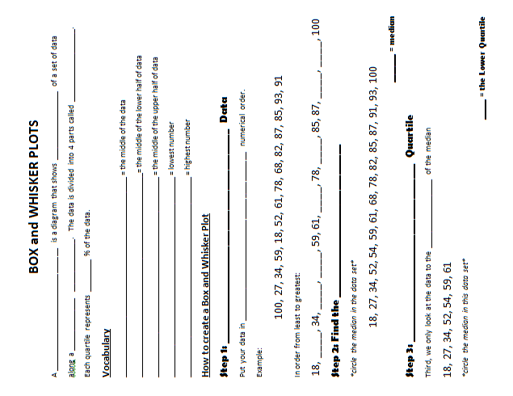
Notes:
guided notes to go with PPT, page 1

Slide 4
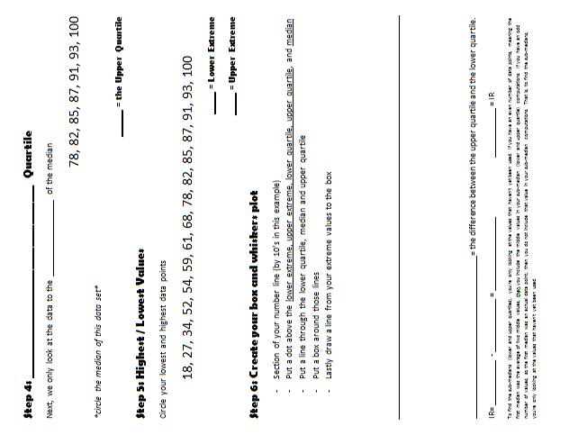
Notes:
guided notes to go with PPT, page 2

Slide 5
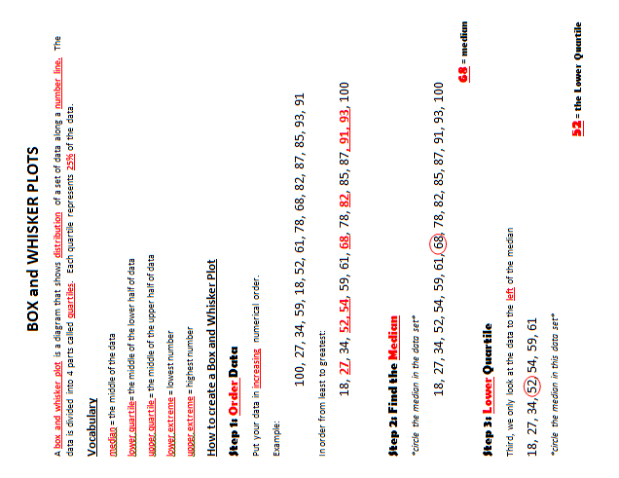
Notes:
answer key page 1

Slide 6
Notes:
answer key page 2

Slide 7
BOX & WHISKER PLOT
Definition:
A box-and-whisker plot is a diagram that shows the distribution of a set of data along a number line. The data is divided into 4 parts called quartiles. Each quartile represents 25% of the data.

Slide 8
NEW VOCABULARY
Median = the middle of the data
Lower Quartile = the middle of the
lower half of data
Upper Quartile = the middle of the
upper half of data
Lower Extreme = lowest number
Upper Extreme = highest number

Slide 9
Introduction
A box-and-whisker plot can be useful for handling many data values.
They allow people to explore data and to draw informal conclusions when two or more variables are present.
It shows only certain statistics rather than all the data.
Box and whisker plots consists of the median, the quartiles, and the smallest and greatest values in the distribution.

Slide 10
How to make a Box and Whisker Plot
Step 1: Order Data
Put your data in increasing numerical order. Example: 100, 27, 34, 54, 59, 18, 52, 61, 78, 68, 82, 87, 85, 93, 91
In order from least to greatest…. 18, 27, 34, 52, 54, 59, 61, 68, 78, 82, 85, 87, 91, 93, 100

Slide 11
Step 2 – Find the Median
How to make a Box &Whisker Plot
18, 27, 34, 52, 54, 59, 61, 68, 78, 82, 85, 87, 91, 93, 100
*The median is the number in the middle of the data*

Slide 12
Step 3 – Lower Quartile
How to make a Box &Whisker Plot
Third, we only look at the data to the left of the median
18, 27, 34, 52, 54, 59, 61, 68, 78, 82, 85, 87, 91, 93, 100.
We find the median of those numbers
18, 27, 34, 52, 54, 59, 61
Notes:
Note: If you have an even number of values, so the first median was the average of the two middle values, then you include the middle values in your sub-median computations. If you have an odd number of values, so the first median was an actual data point, then you do not include that value in your sub-median computations. That is, to find the sub-medians, you're only looking at the values that haven't yet been used.

Slide 13
Step 3 – Lower Quartile
How to make a Box &Whisker Plot
Do not include the median as a data point while finding the Lower Quartile
Third, we only look at the data to the left of the median
18, 27, 34, 52, 54, 59, 61, 68, 78, 82, 85, 87, 91, 93, 100.
We find the median of those numbers
18, 27, 34, 52, 54, 59, 61
Notes:
Note: If you have an even number of values, so the first median was the average of the two middle values, then you include the middle values in your sub-median computations. If you have an odd number of values, so the first median was an actual data point, then you do not include that value in your sub-median computations. That is, to find the sub-medians, you're only looking at the values that haven't yet been used.

Slide 14
Step 3 – Lower Quartile
If you have an even number of data points. Meaning that your first median (53 in this case) was the average of the two middle values, then you do include those numbers (52 and 54) while finding your Lower and Upper Quartile
How to make a Box &Whisker Plot
Median = (52 + 54) / 2= 53
18, 27, 34, 52, 54, 59, 61, 68
We find the median of those
numbers
18, 27, 34, 52,
Different data on this slide for modeling purposes only
Lower Quartile = (27 +34) / 2 = 30.5
Notes:
Note: If you have an even number of values, so the first median was the average of the two middle values, then you include the middle values in your sub-median computations. If you have an odd number of values, so the first median was an actual data point, then you do not include that value in your sub-median computations. That is, to find the sub-medians, you're only looking at the values that haven't yet been used.

Slide 15
Step 4 – Upper Quartile
How to make a Box &Whisker Plot
Next, we only look at the data to the right of the median
18, 27, 34, 52, 54, 59, 61, 68, 78, 82, 85, 87, 91, 93, 100.
We find the median of those numbers
78, 82, 85, 87, 91, 93, 100.

Slide 16
Step 5 – Highest/Lowest Values
How to make a Box &Whisker Plot
Circle your lowest and highest data points
18, 27, 34, 52, 54, 59, 61, 68, 78, 82, 85, 87, 91, 93, 100

Slide 17
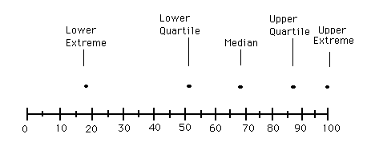
Step 6 – Drawing Graph
How to make a Box &Whisker Plot
18, 27, 34, 52, 54, 59, 61, 68, 78, 82, 85, 87, 91, 93, 100.
Plot the lowest value, lower quartile, median, upper quartile, and the highest value on a number line.

Slide 18
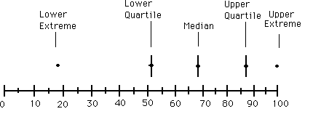
How to make a Box &Whisker Plot
Put a line through the Lower Quartile, Median, and Upper Quartile.
Then Put a box around those lines
Lastly draw a line from your extreme values to the box

Slide 19
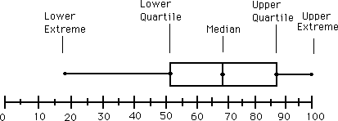
There is your Box and Whisker Plot
Q: Can you guess where
the graph gets it’s name?
How to make a Box &Whisker Plot
5 Number Summary
Lower Extreme=18
Lower Quartile =52
Median= 68
Upper Quartile= 87
Upper Extreme= 100

Slide 20
Interquartile range= the difference between the upper quartile and the lower quartile
How to make a Box &Whisker Plot
Lower Extreme=18
Lower Quartile =52
Median= 68
Upper Quartile= 87
Upper Extreme= 100
87– 52 = 35= IR

Slide 21
Try one more!

Slide 22
Making a Box-and-Whisker Plot
Roller Coaster Heights (ft.)
60 42 100 81 78 70 60 76 44 35
Put in order from least to greatest.
35 42 44 60 60 70 76 78 81 100
Median =
(60 + 70) ÷ 2
= 65
Lower Extreme
Upper Extreme
Lower half
Upper half
35 42 44 60 60 70 76 78 81 100
Lower Quartile
Upper Quartile
30
40
50
60
70
80
90
100
110
35
44
65
78
100

Slide 23
Thanks for buying my product! I hope that it was useful for you. Please let me know if you have any questions. I will be adding science unit power points throughout the remainder of the year. Please check back if this product was useful for you!

Slide 24


Cover Credits

